Slide 1

Ultrasonic Oxygen Sensor Module Gasboard-7500H Series
Gustavo Gil
Kamilla Peixoto

Slide 2
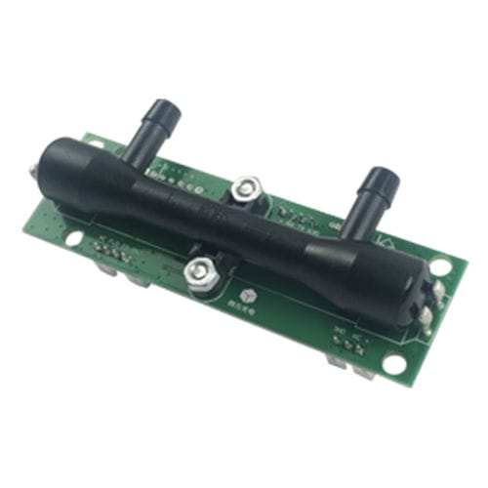
Specification
Model | 7500H | 7500HA-BC
Detect Principle | Ultrasonic Technology
Detection Range | O2 Concentration: 0%~100%
 | Flow Rate: 0~10L/min | Flow Rate:0~2L/min
Accuracy | O2 Conc.: ±1.5%FS | O2 Conc.: ±1.5%FS
 | Flow Rate: ±0.2L/min | Flow Rate: ±0.1L/min
Resolution | O2 Concentration: 0.1%
 | Flow Rate: 0.1L/min | Flow Rate: 0.01L/min
Data Update Time | 100ms (10 samples per seconds)
Communication Interface | UART_TTL (3.3V)

Slide 3
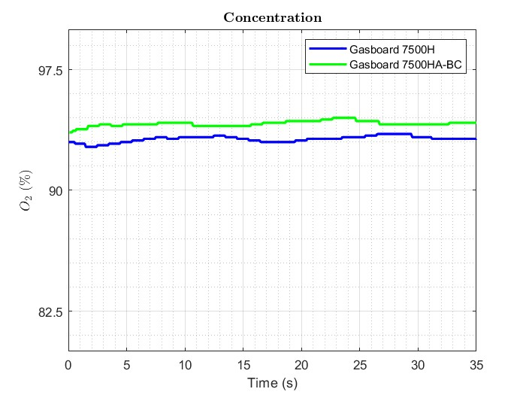
Concentration
Oscillations are inside the accuracy range (1.5%).
Gasboard 7500H-ABC reads a value slightly closer to the Horizon P5 (98%)
Fig. 1: Oxygen Concentration. Horizon P5 Parameters: 98%, 25BPM, 1.00.

Slide 4
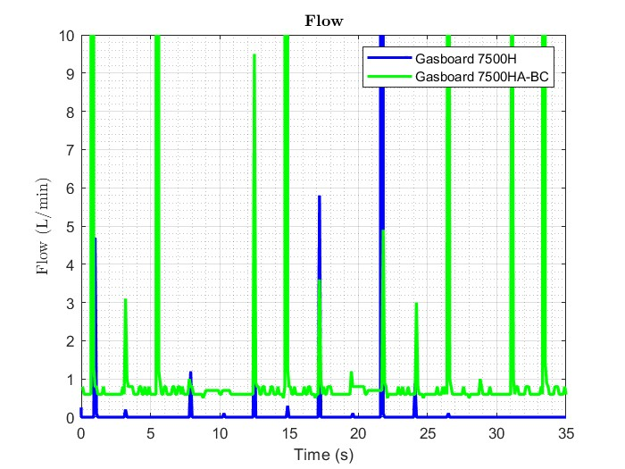
Flow
Gasboard 7500H-ABC saturates in almost all the peaks.
Gasboard 7500H-ABC is able to read small flow fluctuations.
There is more loss of data on Gasboard 7500H .
Experiments using Gasboard 7500H are not repeatable.
Fig. 2: Flow Horizon P5 Parameters: 98%, 25BPM, 1.00.

Slide 5
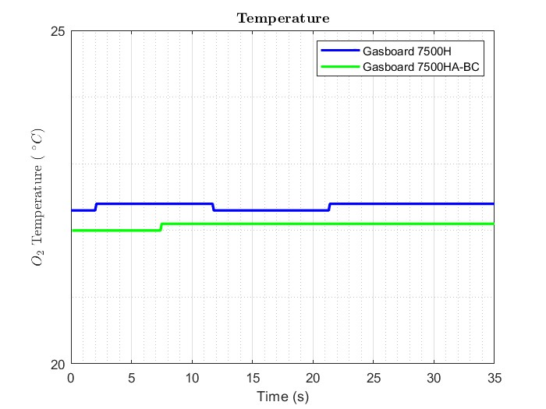
Temperature
Data sheet does not provide detailed information about the temperature readings.
Fig. 3: Temperature Horizon P5 Parameters: 98%, 25BPM, 1.00.

Slide 6
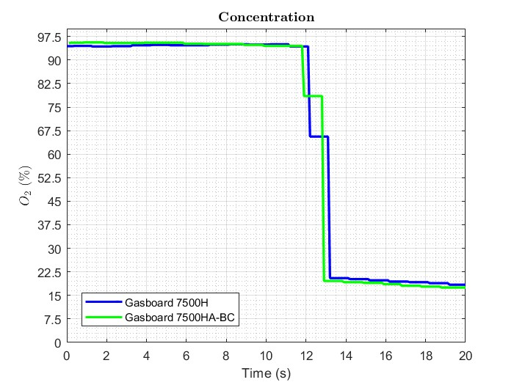
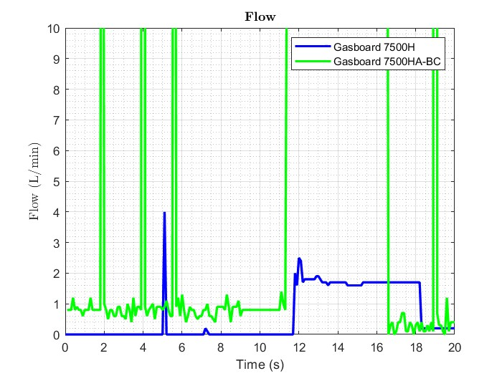
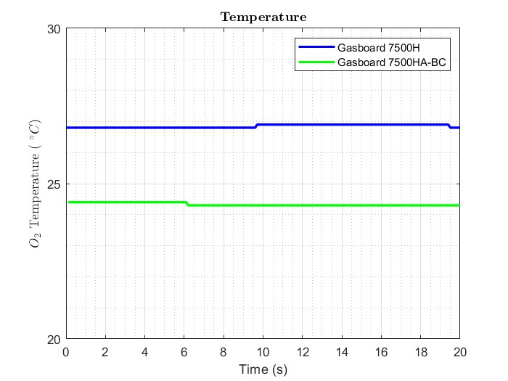

Step Down
Both sensors can decrease their readings in a big range in just one sample.
In no flow conditions, the sensors keep reading the residual air with high$O_{2}$ concentration.
Fig. 4: Concentration, Flow and Temperature for the Step Down Experiment. Horizon P5 Parameters: 98%, 15BPM, 0.50.

Slide 7
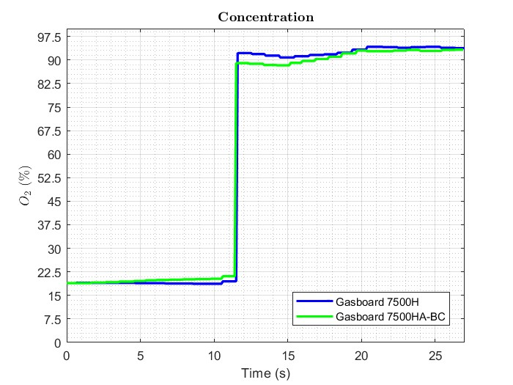
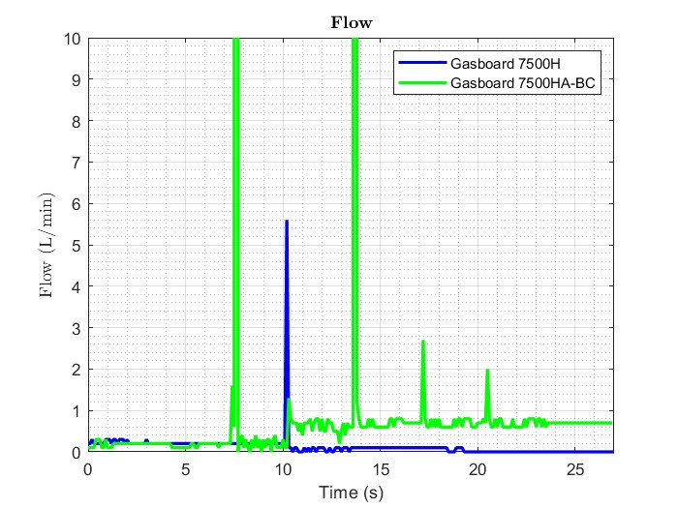
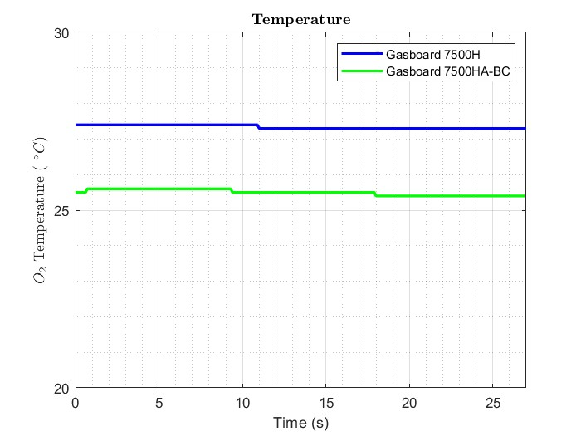
Step Up
Both sensors can increase their readings in a big range in just one sample.
Both sensors takes around 6 seconds to achieve the final value.
Fig. 5: Concentration, Flow and Temperature for the Step Up Experiment. Horizon P5 Parameters: 98%, 15BPM, 0.50.

Slide 8
Other Observations
The bigger the value of the concentrator`s parameter “Settings”, the more the sensor saturates while reading the flow. However, if the values are too small, the sensor is not able to identify all the peaks, so there is a loss of data. Also, there is no major influence on the flow and temperature.
Default and Extended reading modes do not have a significant impact on the flow and temperature readings, just on the oxygen concentration.
The hose used to connect the concentrator and the sensor does not influence the readings.
When decreasing the sample time to values less than the minimum recommended by the data sheet, the sensor is still able to send data, but it should be further analyzed.

